Slide 1

Statistical Analysis of the Omaha Girls Rock Program
Joshua Ellis, Alex Daly, and Satwik Chandra
Video Presentation: VidGrid - Final Presentation Group 2 OGR Data
Source Code and Data: omaha-girls-rock-analysis/exploratory-analysis.html at master · josh97ellis/omaha-girls-rock-analysis (github.com)

Slide 2

Agenda
The Data + Descriptive Statistics
Descriptive Analysis
Research Topic 1 Statistical Analysis
Research Topic 2 Statistical Analysis
Important Additional Finding
Conclusion

Slide 3
The Data
Omaha Girls Rock Survey Data
Data Cleaning Process
Descriptive Statistics
Categorical Count Plots
Numeric Distributions
Answer Ratings Boxplot
Correlation Heatmap

Slide 4

Omaha Girls Rock Survey Data
Local non-profit
Focuses on developing girl’s social skills through music programs
Provides survey pre and post programs asking likelihood to do various social activities
Data was processed before models were created

Slide 5
Data Cleaning Steps
Combine and tag many tables into one (8 -> 1)
1
Standardize Client Id’s between the years
2
Format Colum Headers
3
Convert Data Types
4
Regroup Race/Ethnicity due to Imbalances
5
Enumerate categorical survey questions
6
Replace NA values with median value
7
Drop Unused Column
8

Slide 6
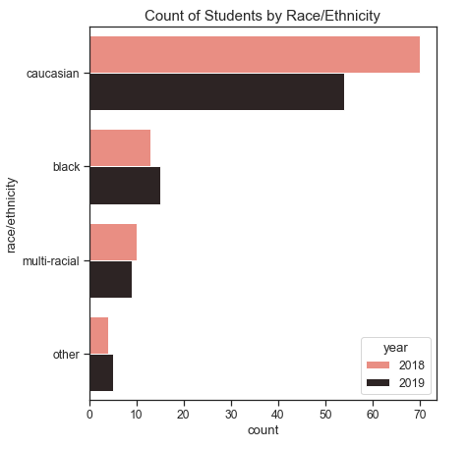
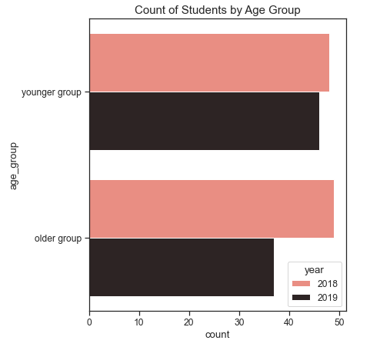
Descriptive Statistics
Race and Age Distributions

Slide 7
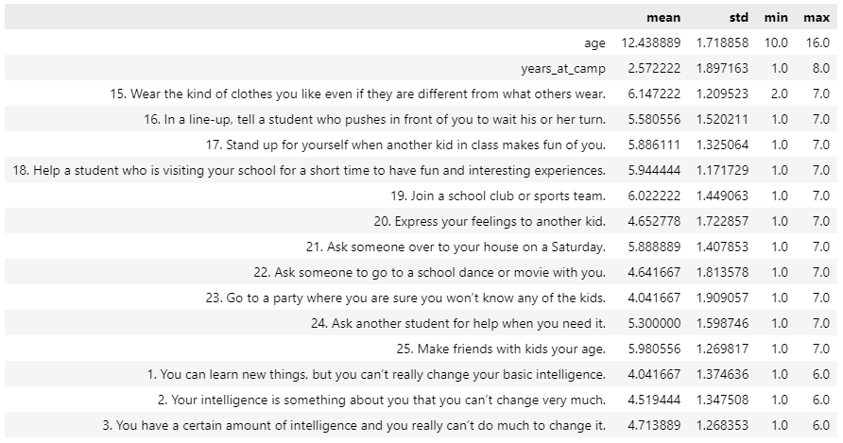
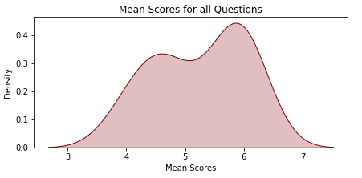
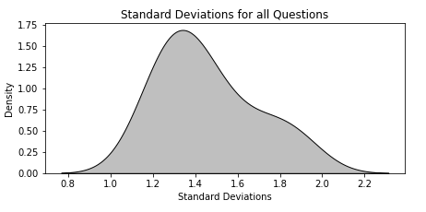
Descriptive Statistics
Variable Summaries
Kernel Density Estimation (KDE) Plots

Slide 8
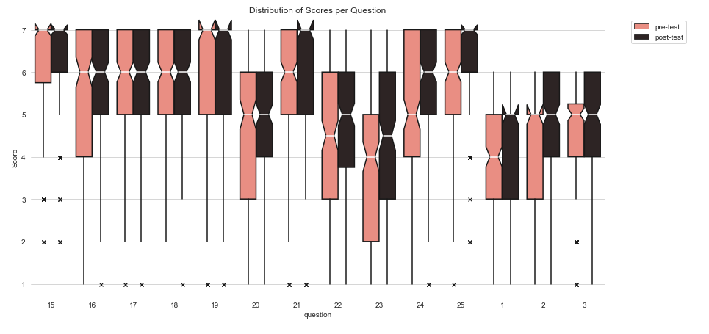
Descriptive Statistics
Answer Rating (Scores) by Question

Slide 9
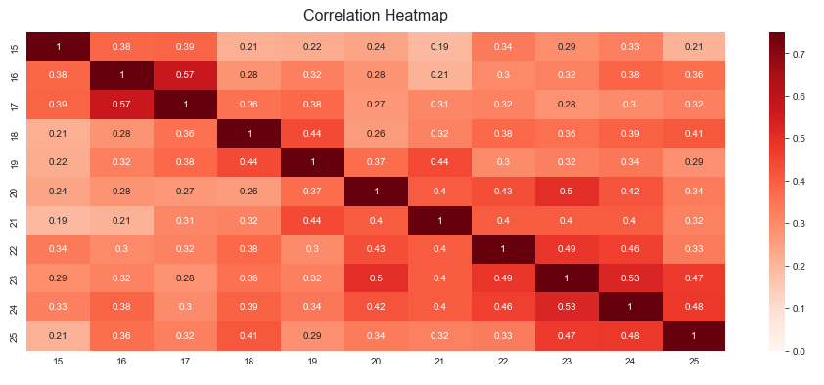
Descriptive Statistics
Correlation Between Questions
16. In a line-up, tell a student who pushes in front of you to wait his or her turn.
17. Stand up for yourself when another kid in class makes fun of you.
20. Express your feelings to another kid.
23. Go to a party where you are sure you won’t know any of the kids.
24. Ask another student for help when you need it.

Slide 10

Are There Significant Differences in Answer Ratings for Various Outcomes in the Younger Group and the Older Group?
Research Topic 1
Compare Answer Ratings Between Age Groups
Compare Pre-Test and Post-Test Answer Ratings
Compare Delta Scores Between Age Groups

Slide 11
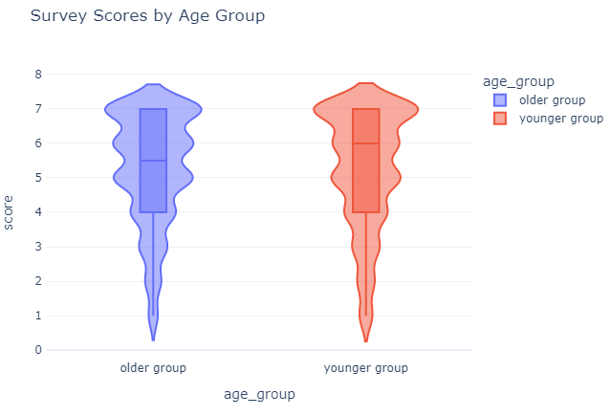


Compare Answer Ratings Between Groups
Are the mean answer ratings different between the older group and the group?
Test
Two-tailed independent t-test at a 5% level of significance
Hypotheses
$H_{0}: μ_{younger}=μ_{older}$
$H_{a}:μ_{younger}≠μ_{older}$
Conclusion
There is not enough evidence in the data to reject the null hypothesis. Therefore, we are unable to claim that there is any statistically significant difference in the mean answer rating between the two age groups
t-statistic: 0.4938
p-value: 0.6215

Slide 12
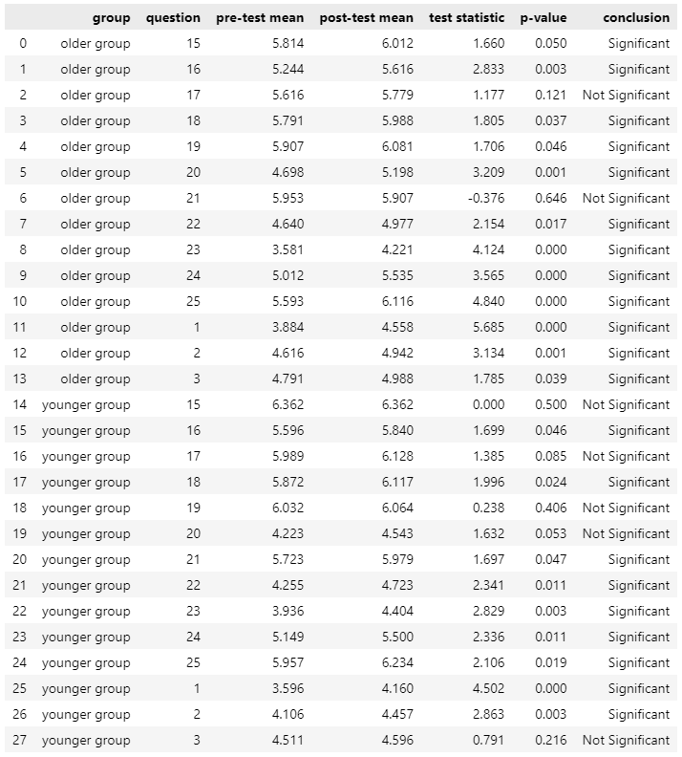

Compare Pre-Test and Post-Test Answer Ratings
For each question, is there a significant difference between the pre-test and the post-test (by age group)
Results
Test
Right-tailed dependent (matched-sample) t-test at a 5% level of significance
Individual test for each question-age group combination (2 groups x 14 questions)
Hypotheses
$H_{0}: μ_{d} ≤0$
$H_{a}: μ_{d}>0$
Conclusion
Program slightly more effective for participants in the older group, overall not much different.
Older Group: 12 out of 14 questions have a statistically significant improvement between the pre- and post-test scores.
Younger Group: 9 out of 14 questions have a statistically significant improvement between the pre- and post-test scores.

Slide 13
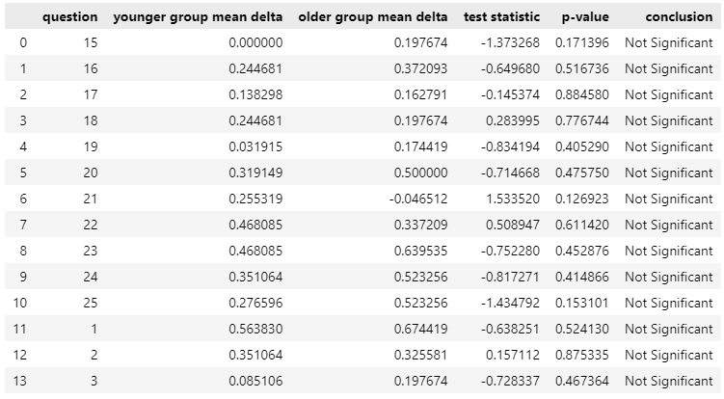

Compare Delta Scores Between Age Groups
For each question, did either age group improve significantly more than the other?
Test
Two-sided independent t-test about the difference in means between the delta scores of the Younger Group ($μ_{1}$) and Older Group ($μ_{2})$.
Individual test for each question (14)
Hypotheses
$H_{0}: μ_{younger}− μ_{older}=0$
$H_{a}:μ_{younger}− μ_{older}≠0$
Conclusion
The delta score between age groups is not significantly different for any question on the survey, as a result, fail to reject the null hypothesis for any of the 14 questions.
No age group improved significantly more than the other on any question.
Results
Note: Delta Score = Post-Test Score – Pre-Test Score
The delta score is a measure of the effectiveness of the OGR program.

Slide 14
Does the race/ethnicity of participants influence the change in score for various questions over time?
Research Topic 2
One-way ANOVA (per question)
Two-way ANOVA (Race + Question)
One-Way ANOVA (per personality trait)
Note: Delta Score = Post-Test Score – Pre-Test Score
The delta score is a measure of the effectiveness of the OGR program.

Slide 15
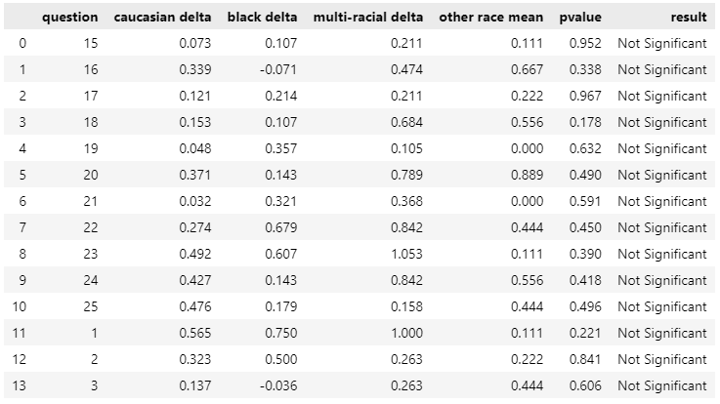

One-way ANOVA (per question)
For each question, is there a significant difference in the delta scores between each race/ethnicity?
Test
One-way ANOVA test about the means between the delta scores for the different racial identities
Hypotheses
$H_{0}: μ_{caucasian}=μ_{Black}=$ $μ_{multi−racial}=$ $μ_{other}$
$H_{a}:not all population means are equal$
Results
There is not a statistically significant difference between the delta scores for all the groups, meaning we cannot reject the null hypothesis
One-Way ANOVA Results, Treatment = Race/Ethnicity for n Questions
Note: Delta Score = Post-Test Score – Pre-Test Score
The delta score is a measure of the effectiveness of the OGR program.

Slide 16
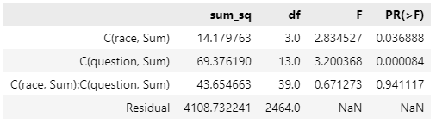

Two-Way ANOVA (Race + Question)
Test if race and question (and the interaction of race + question) have a significant effect on the delta scores
Test
Two-Factor Experiment about the means between the delta scores for the different racial identities
Hypotheses
$H_{0}: μ_{caucasian}=μ_{Black}=$ $μ_{multi−racial}=$ $μ_{other}$
$H_{a}:not all population means are equal$
Results
There is a difference in average delta scores by racial groups
There is a difference in average delta scores by questions
Interaction between racial identity and the questions is not significant
Note: Delta Score = Post-Test Score – Pre-Test Score
The delta score is a measure of the effectiveness of the OGR program.

Slide 17
Survey Question | Personality Trait Category
15. Wear the kind of clothes you like even if they are different from what others wear. | Openness
16. In a line-up, tell a student who pushes in front of you to wait his or her turn. | Extraversion
17. Stand up for yourself when another kid in class makes fun of you. | Extraversion
18. Help a student who is visiting your school for a short time to have fun and interesting experiences. | Agreeableness
19. Join a school club or sports team. | Openness
20. Express your feelings to another kid. | Agreeableness
21. Ask someone over to your house on a Saturday. | Extraversion
22. Ask someone to go to a school dance or movie with you. | Extraversion
23. Go to a party where you are sure you won’t know any of the kids. | Openness
24. Ask another student for help when you need it. | Agreeableness
25. Make friends with kids your age. | Extraversion
1. You can learn new things, but you can’t really change your basic intelligence. | Growth Mindset
2. Your intelligence is something about you that you can’t change very much. | Growth Mindset
3. You have a certain amount of intelligence and you really can’t do much to change it. | Growth Mindset
Big 5 Personality Traits: The 5-Factor Model of Personality (verywellmind.com)

Slide 18
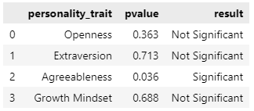

One-Way ANOVA (Per Personality Trait)
For each personality trait, is there a significant difference in the delta scores between each race/ethnicity?
Test
One-way ANOVA test about the means between the delta scores for the different racial identities
Hypotheses
$H_{0}: μ_{caucasian}=μ_{Black}=$ $μ_{multi−racial}=$ $μ_{other}$
$H_{a}:not all population means are equal$
Results
At least One racial group had a significant change in the post-test compared to the pre-test on questions related to Agreeableness
A Fishers LSD (Pairwise Comparisons) test should be performed to identify which population(s) are different
14 survey question grouped into 4 personality trait categories
Results
Note: Delta Score = Post-Test Score – Pre-Test Score
The delta score is a measure of the effectiveness of the OGR program.

Slide 19
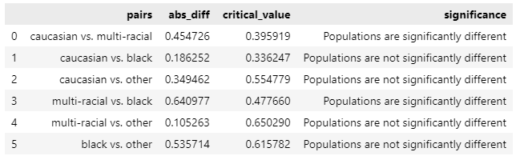

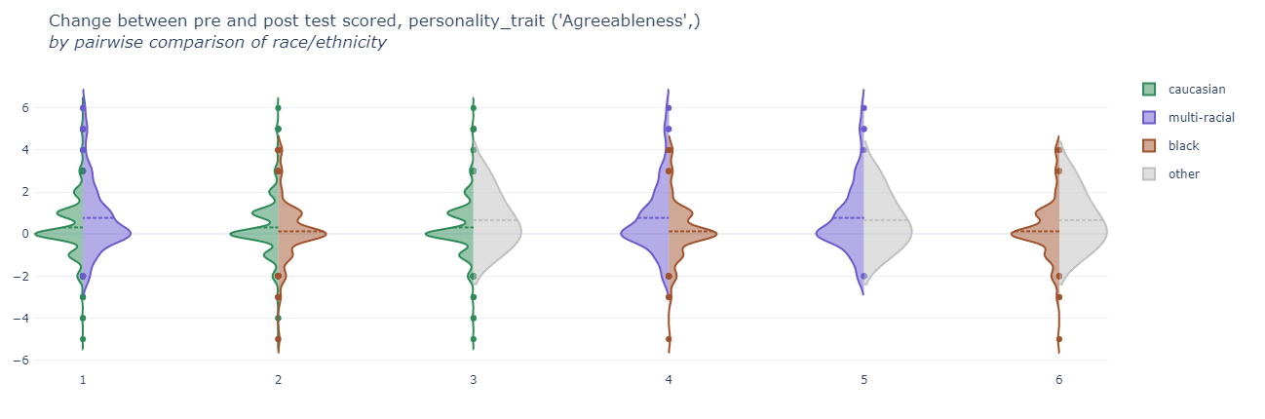
Fisher’s Least Significant Difference (LSD) performed on delta scores related to Agreeableness
Possibly influenced by small samples size in the multi-racial group with a few outliers

Slide 20

Important Additional Finding

Slide 21
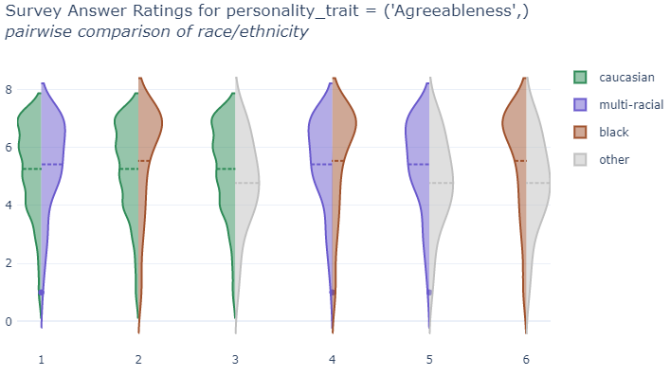
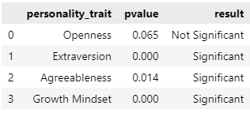
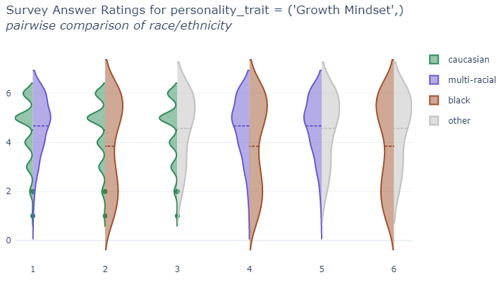
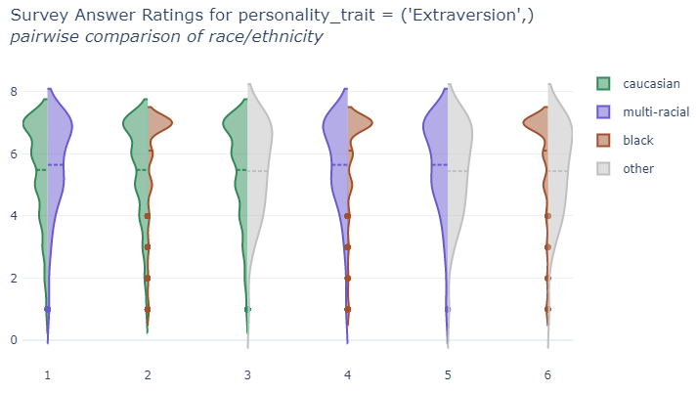
Comparison between race and personality trait for overall answer ratings
4 One-Way ANOVA Tests for each Personality Trait, Treatment = Race/Ethnicity

Slide 22
Statistical Conclusions
No Substantial differences in Survey Scores or Program Effectiveness between age groups
Minimal differences in Program effectiveness between racial groups
Substantial differences in answer rating between racial groups when grouping individual questions into personality trait categories {Extraversion, Agreeableness, Growth Mindset}

